Slide 1


Achimugu A . S
20th May 2022

Slide 2

Outline
Executive Summary
Introduction
Methodology
Results
Conclusion
Appendix
<number>
Notes:
<number>

Slide 3
Executive Summary
This project data were collected via SpaceX REST API and web scrapping.
Analysis of data specifically for different launching site shows that the maximum number of launches for Falcon 9 Rockets were from Cape Carnival site and GTO orbit accounted for maximum deployment.
Decision Tree algorithm performed best among other classification algorithms to predict the successful landing of Falcon 9 Rockets.
KSC LC launch site showed the highest success rate while Orbit of payload deployment and payload mass were found to have good correlation with the success of the mission.
2

Slide 4
Introduction
Project background and context
We predicted if the Falcon 9 first stage will land successfully. Space X advertises Falcon 9 rocket on it website, with a cost of 62 million dollars; other provider cost upward of 165 million dollar each, much of the saving is because Space X can reuse the first stage. Therefore, if we can determine it the first stage will land, we can determine the cost of a launch. This information can be used if an alternate company wants to be against Space X for a rocket launch. .
Problems you want to find answers
What factor affect successful landing of rockets
The effect of each relationship of rocket variables to outcome
Which conditions will enable spaceX in a successful landing
3

Slide 5

Section 1
4

Slide 6
Methodology
Executive Summary
Data collection methodology:
Via SpaceX Rest API
Web Scraping from Wikipedia
Perform data wrangling
By dropping irrelevant columns and perform one hot encoding
Perform exploratory data analysis (EDA)
Using Bar graph and Scatter plot to show relationship between variables
Perform predictive analysis using classification models
Used several classification model, tuned each model using gridsearchcv for best parameters and evaluated model accuracy score and confusion matrix
4
Notes:
<number>

Slide 7
Data Collection
For the purpose of finding the cost of launches, we needed amount of rocket launches data of at least of 5 years. Only falcon 9 Rockets was considered for the purpose of study and related fields like date of launch, location of launch, payload mass, booster version, orbit of deployment, etc. were taken into consideration. Data Collection was done through REST API from SpaceX API website website and web scrapping was carried out from wikipeadia
Make Pandas dataframe
Getting data from API
Getting data from Web
Export to flat file CSV
<number>

Slide 8
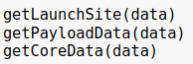
Data Collection – SpaceX API
Response from API
Json to Dataframe
Functions to clean data
Export to flat file
Notebook
<number>

Slide 9
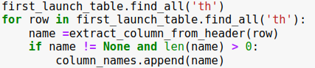
Data Collection - Scraping
Getting response from HTML
Creating Beautifulsoup object
Extracting all columns
Creating pandas dataframe
<number>
Notebook

Slide 10





Data Wrangling
The majoy cleaning here was converting the outcome to labels where 1 and 0 mean sucessfull and unsucssfull landing
1. Load Data
3. Data Cleaning
6. Save to csv
2. MakeDataframe
5. Convert Outcome to Labes
Notebook
<number>

Slide 11
EDA with Data Visualization
Visualisation was done Seaborn Scatter plot, Bar plot and Line plot;
Scatter plot was used to show the relationship between fight number and launch sight, payload and launch sight, flight number and orbit type, and pay load and orbit type
Bar chart was used to show the comparisons between mean success rate for each orbit. Oribit is a categorical data hence the choice of Bar chart.
Line plot was used to show the the trend in successfull landing from 2013 to 2020
<number>

Slide 12
Build an Interactive Map with Folium
Using Folium libarary;
We took the latitude and longitude co-ordinates at each launch site and added a circle marker around each launch site with a label of the name of the launch site inother to visualize the launch data on an interactive map.
We assigned the dataframe launch_outcomes(failures, successes) to classes 0 and 1 with Green and Red markers on the map in a MarkerCluster
Using Haversine’s formula we also calculated the distance from the launch Site to various landmarks to find various trends about what is around the Launch Site to find patterns.
11

Slide 13
Predictive Analysis (Classification)
1. Load and standardize data
3. Fit model and tune hyperparameter
5. Choose the best model
2. Split data into train and test data
4. Evaluate Model
12
Notebook

Slide 14

Section 2

Slide 15
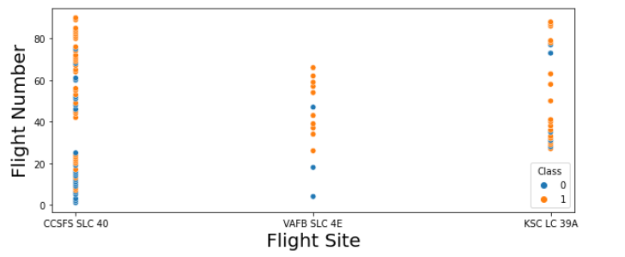
Flight Number vs. Launch Site
The more amount of flights at a launch site the greater the success rate at a launch site.
<number>

Slide 16
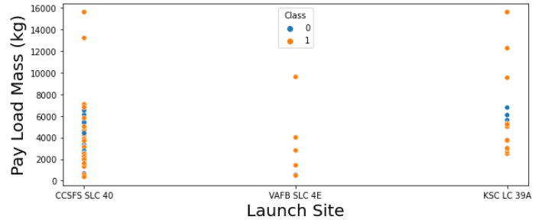
Payload vs. Launch Site
There is not quite a clear pattern to be found using this visualization to make a decision if the Launch Site is dependant on Pay Load Mass for a success launch.
<number>

Slide 17
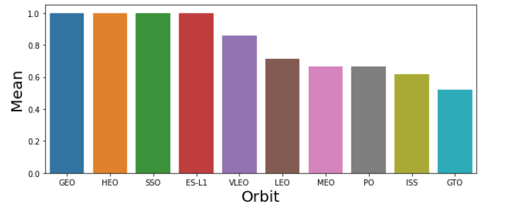
Success Rate vs. Orbit Type
Orbit GEO,HEO,SSO,ES-L1 has the best Success Rate
<number>

Slide 18
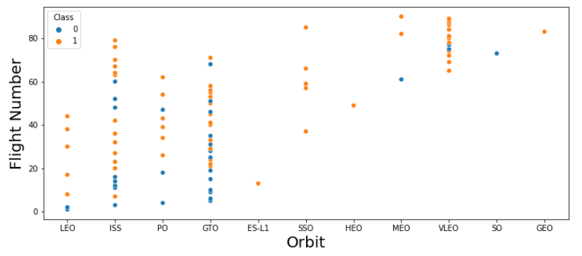
Flight Number vs. Orbit Type
There seems to be no relationship between flight number when in GTO orbit.
<number>

Slide 19
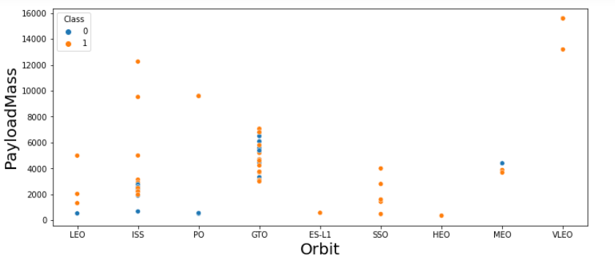
Payload vs. Orbit Type
Heavy payloads have a negative influence on GTO orbits and positive influence LEO, ISS orbits.
<number>

Slide 20
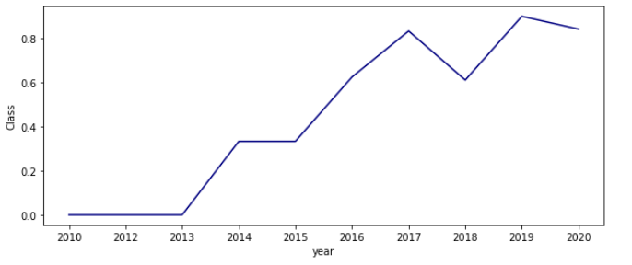

Launch Success Yearly Trend
From 2013 they has been steady increase in the successfull lauches although they is a deep in 2017 but picked backup in 2018
<number>

Slide 21

Section 3

Slide 22
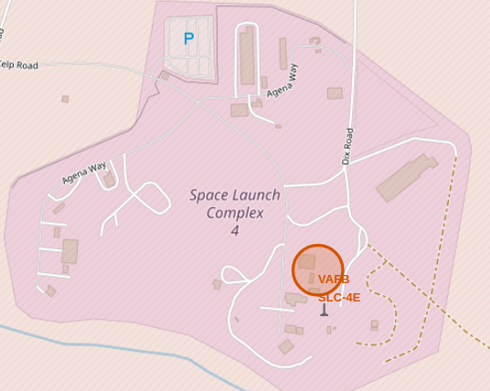
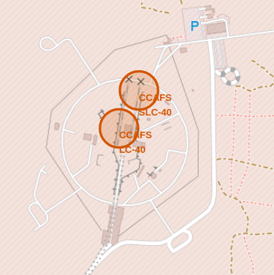
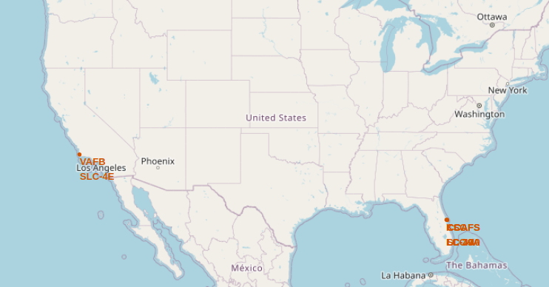
Launch Sites
Launch sites are in very close proximity to the coastline
<number>

Slide 23
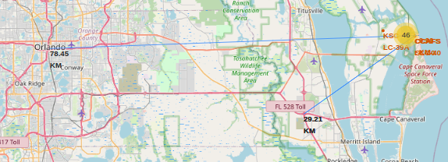
CCAFS SLC-40 from Cities and Highway
From CCAFS SLC-40 to the coastline is 0.09km while to Orlando city is 78.45km and to the nearest high way is 29.21km
<number>

Slide 24

Section 4

Slide 25
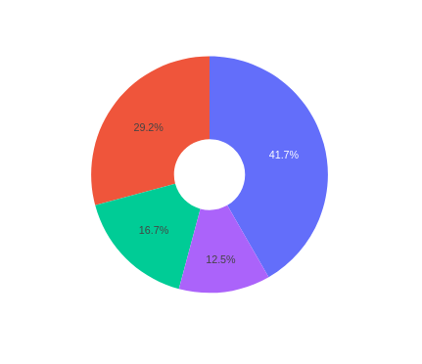
Launch Success Count by Sites
KSLC LC-39A 41.7%
CCAFS LC-40 29.2%
VAFB SLC-4E 16.7%
CCAFS SLC-40 12.5%
KSLC LC-39A has the largest number of successful launches
25

Slide 26
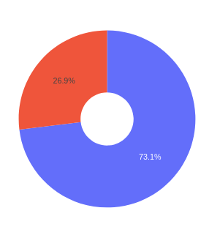
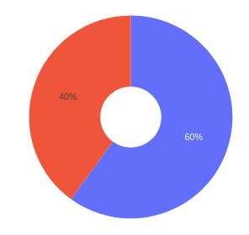
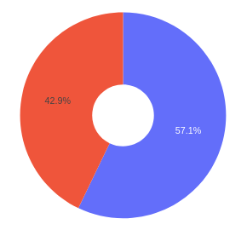
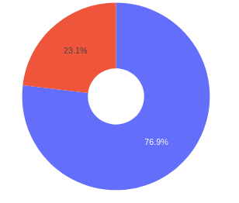
Site Outcomes
KSLC LC-39A
VAFB SLC-4E
CCAFS LC-40
CCAFS SLC-40
0
1
KSC LC 39A has highest success rate among all sites
<number>

Slide 27

Section 5

Slide 28
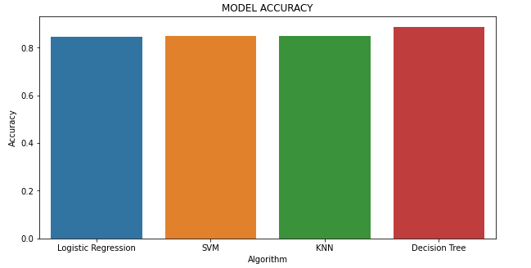
Classification Accuracy
Decision Tree Classifier performed best with an accuracy of 88.87%
criterion: gini
max_depth: 10, max_features: sqrt min_samples_leaf: 1 min_samples_split: 2 splitter: random
<number>

Slide 29
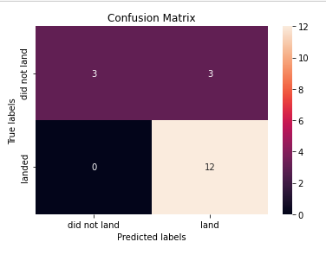
Confusion Matrix
False Positive 3 means the model predicted 3 unsessfull landing as succss full. True nagetive false nagative and true positive all ok
<number>

Slide 30
Conclusions
1. Falcon 9 rockets launched from KSC will be more successful than other launch sites and any payload mass between 2k-4k will have higher chances of successful mission
2. Landing success depends on many features like the physical working attributes of a rocket, orbit of payload
3. The success rate for SpaceX is directly proportional to time in years. With more time, they will eventually perfect the launches
4. The best classifier is Decision tree with an accuracy of 88.87%
…
<number>

Slide 31
Appendix
Folium
Plotly
30
Notes:
<number>

Slide 32


